Slide 1

High-Performance Synchronous Reluctance Motors
Parisa Rezapour
Supervisor: Prof. Emine Bostancı Özkan
Fall 2022

Slide 2
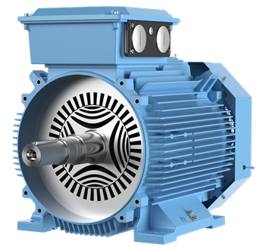
Content
Introduction
Aim of the Study
Working Principle of Synchronous Reluctance Motor
Design and Optimization of Synchronous Reluctance Motor
Rotor Geometries
Motor Specifications
Design Variables
Optimization Procedure
Genetic Algorithm Results
Comparison with an ABB motor
Conclusion
ABB synchronous reluctance motor

Slide 3
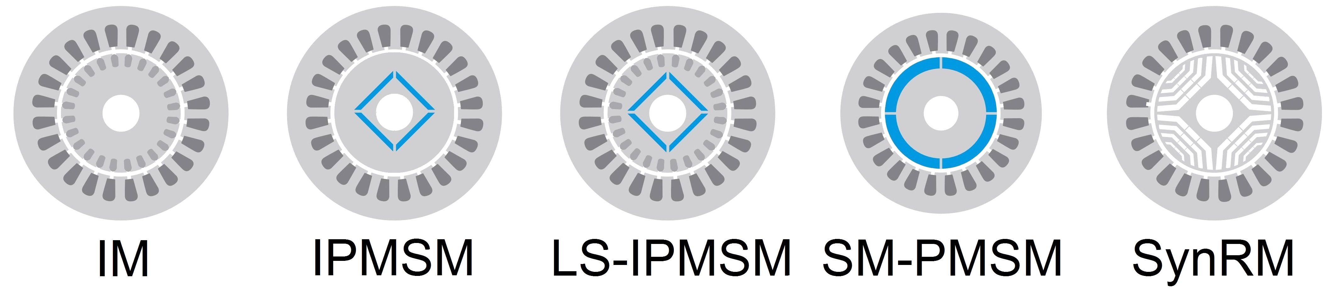
Introduction
Popular motor types in the recent years:
Interior permanent magnet synchronous motor (IPMSM)
Induction motor (IM)
Synchronous reluctance motor (SynRM)
Air (barrier)
Magnetic material

Slide 4

Introduction
Advantages and Disadvantages of SynRMs
Simplicity
Low cost
Higher efficiency compared to IMs
Higher power density compared to IMs
Poor power factor
High torque ripple
SynRM

Slide 5
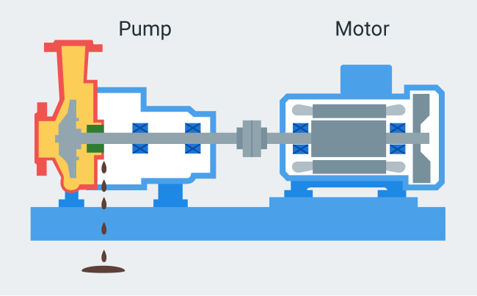

Introduction
Applications of SynRMs:
Industrial applications, e.g., fans and pumps
Electric vehicles

Slide 6
Aim of the Study
Designing and Optimizing an 11-kW Synchronous Reluctance Motor
Efficiency > 93.3%
Torque Ripple < 20%
Industrial Application
ABB synchronous reluctance motor

Slide 7
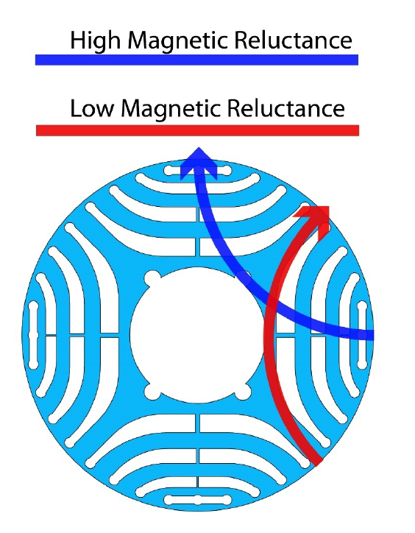
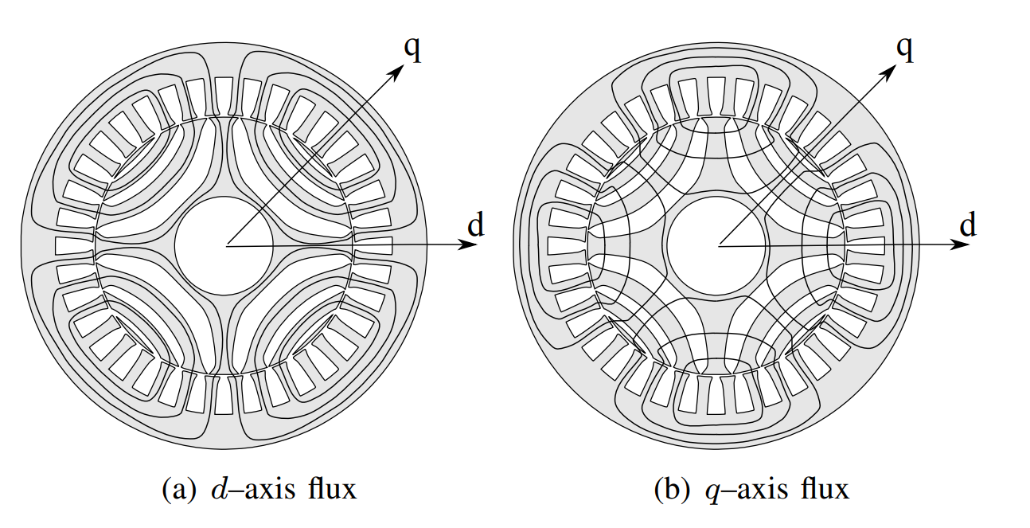
Working Principle of Synchronous Reluctance Motor
d-axis: the axis with the highest amount of flux passing through it
q-axis: the axis with the lowest amount of flux passing through it
Definition of d and q axes¹
Air (barrier)
d-axis flux²
q-axis flux²
¹www.oemerspa.com
Magnetic material
²Nicola Bianchi, 2013

Slide 8
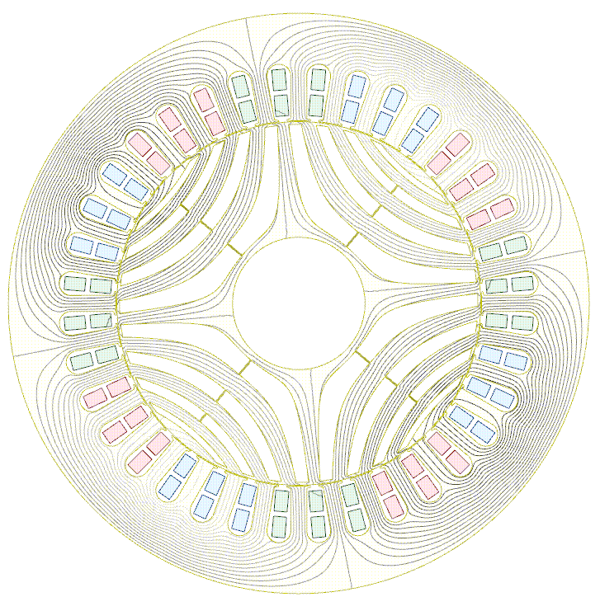
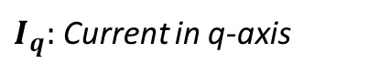
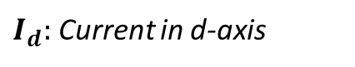
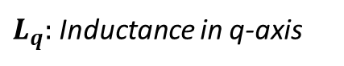
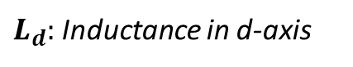
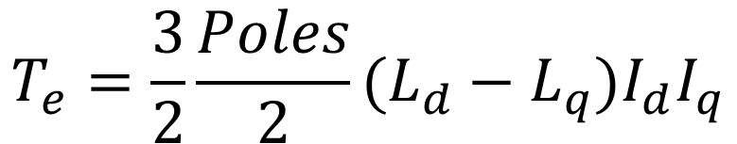
Working Principle of Synchronous Reluctance Motor
Torque equation:
$$T_{e}=\frac{3}{2}\frac{Poles}{2}(L_{d}−L_{q})I_{d}I_{q}$$
$L_{d}:$ Inductance in d-axis
$I_{d}:$ Current in d-axis
$L_{q}:$ Inductance in q-axis
$I_{q}:$ Current in q-axis
The rotating magnetic field and the rotor following it

Slide 9
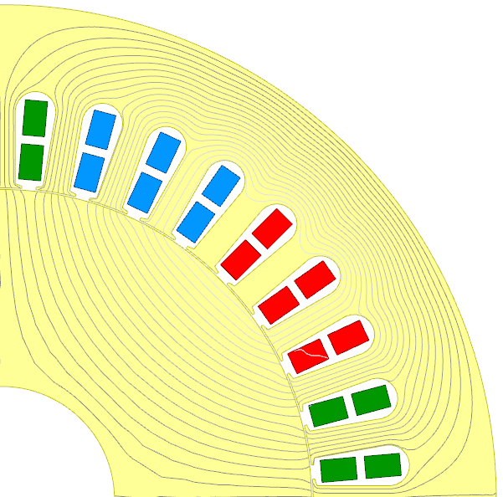
Design and Optimization of SynRM: Rotor Geometries
Circular
Zhukovski
Segmented
Zhukovski barriers do not interrupt the natural path of the flux.
Natural flux lines in motor with solid rotor
The Rediscovery of Synchronous Reluctance and Ferrite Permanent Magnet Motors, 2016

Slide 10
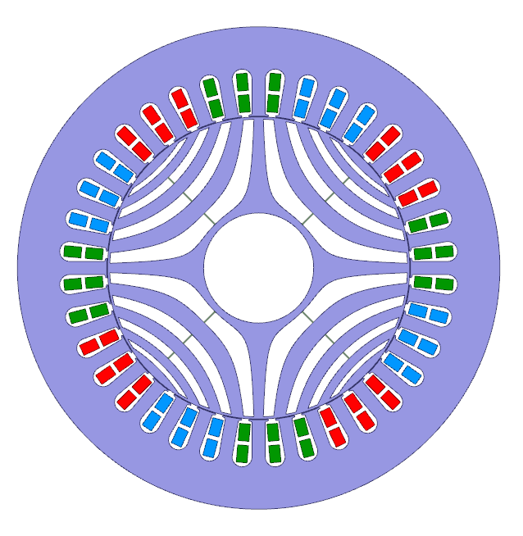
Design and Optimization of SynRM: Motor Specifications
Motor Specifications
Output power (kW) | 11
Axial length (mm) | 190
Stator outer diameter (mm) | 210
Airgap (mm) | 0.35
Number of slots | 36
Number of poles | 4
Number of barriers | 4
Mechanical speed (rpm) | 1500
Goals
Efficiency (%) | >93.3
Torque ripple (%) | <20
2D Model of the investigated SynRM in ANSYS MAXWELL

Slide 11
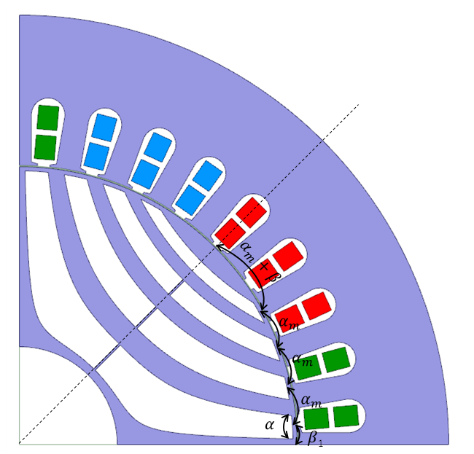
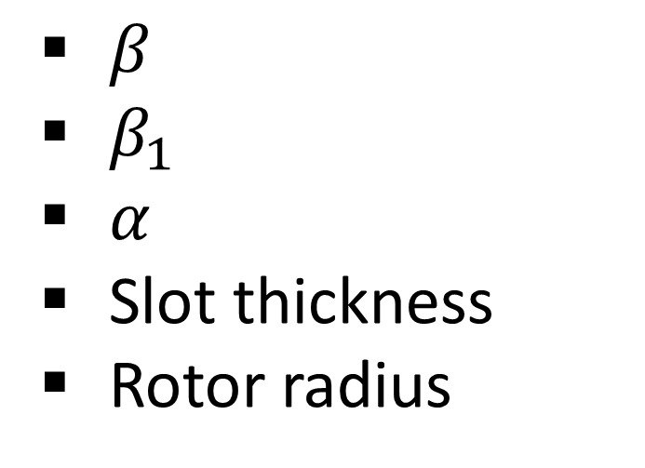
Design and Optimization of SynRM: Design Variables
$β$
$β_{1}$
$α$
Slot thickness
Rotor radius
Slot thickness
Rotor radius
Design variables of the optimized design

Slide 12


Design and Optimization of SynRM: Optimization Procedure
Optimization of the SynRM using Genetic Algorithm (GA)
8 Generations, 140 population
Objectives:
Minimizing torque ripple
Maximizing efficiency
Creating the generations
Performance characteristics
Eliminations
Finite element analysis
Torque
Loss

Slide 13
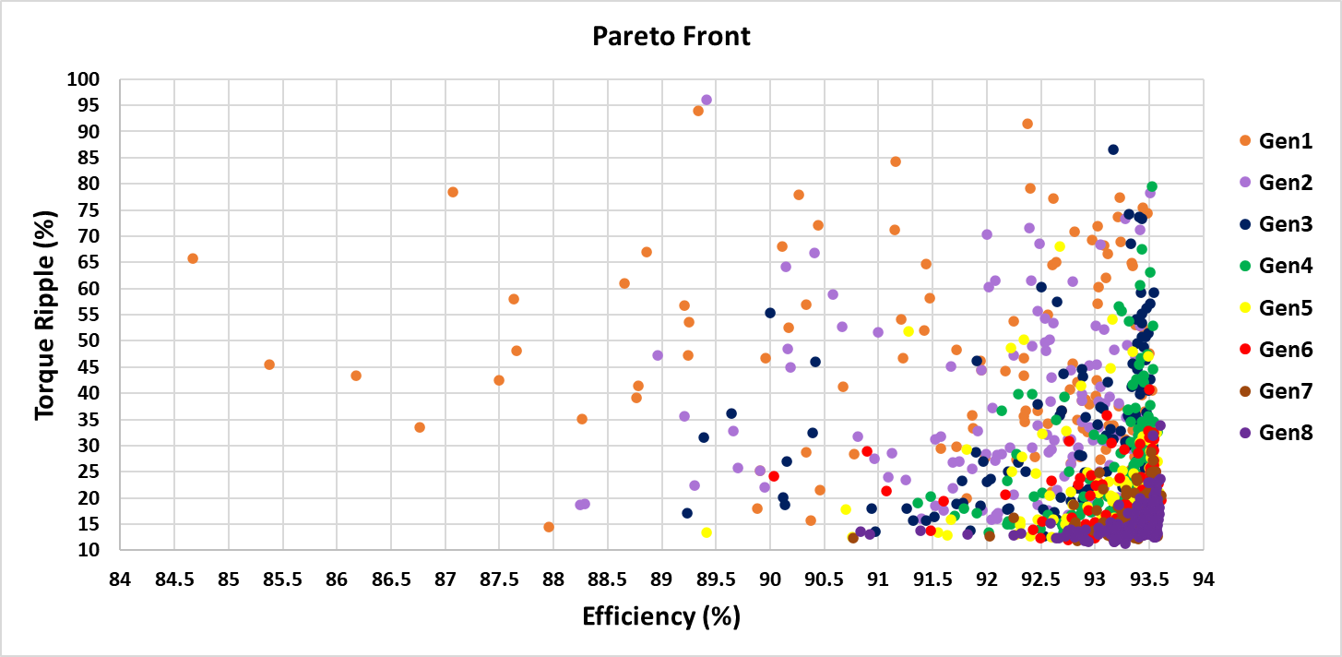
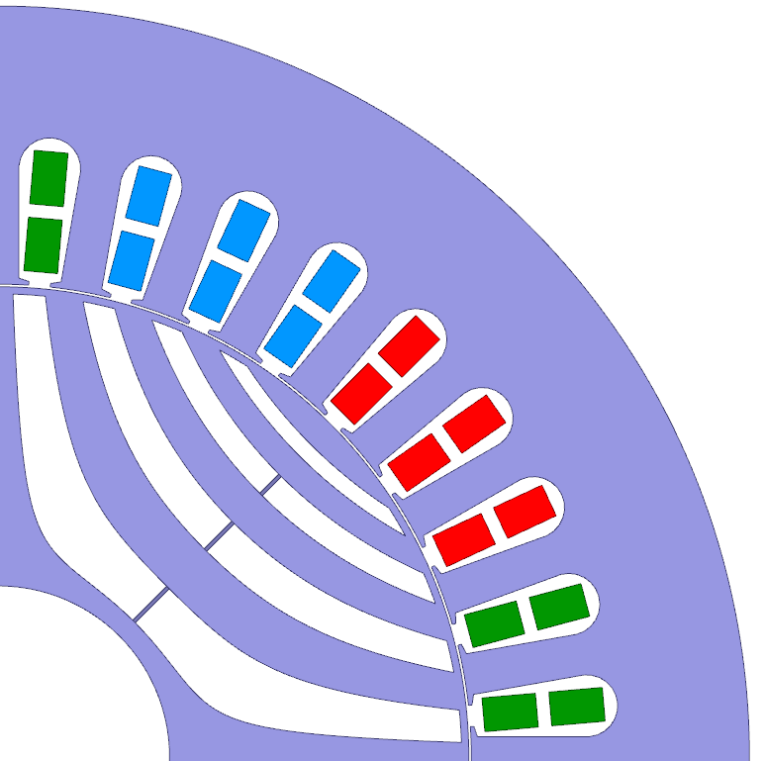
Design and Optimization of SynRM: Genetic Algorithm Results
Sample Design
Efficiency (%) | 93.508
Torque ripple (%) | 13.35
Sample Design

Slide 14
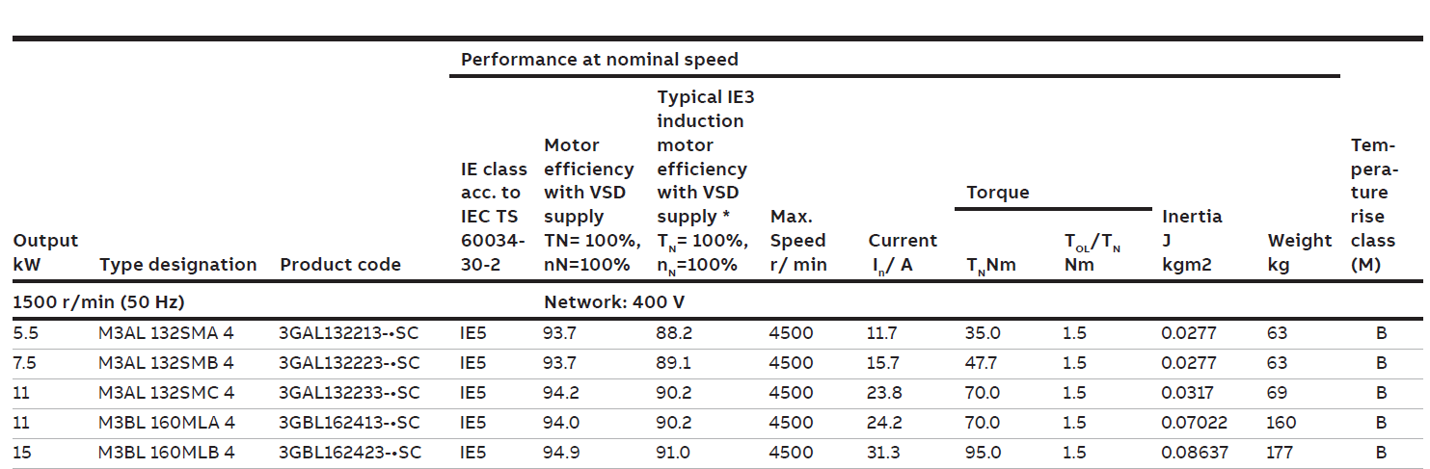
Comparison with ABB motor
ABB IE5 Electric Motor Catalogue
Represents the IE5 class
Output (kW) | Frame | IE Class | Motor Efficiency | IE3 Induction Motor Efficiency
11 | 132 mm | IE5 | 94.2 | 90.2
Actual efficiency range of IE5, considering 15% more loss: [93.39%-100%]
https://salter.com.tr/files/elektrikMotorlari/abb-ie5-elektrik-motor-katalog.pdf

Slide 15
Conclusion
An 11-kW synchronous reluctance motor was designed and optimized
Efficiency goes up to 93.6% (IE5 class)
Acceptable torque ripple in high efficiencies (13%)
This designs reaches the standards of the ABB motor of same rating
Comparable design with induction motors of the same rating

Slide 16
Thank you for your attention

